Slide 1
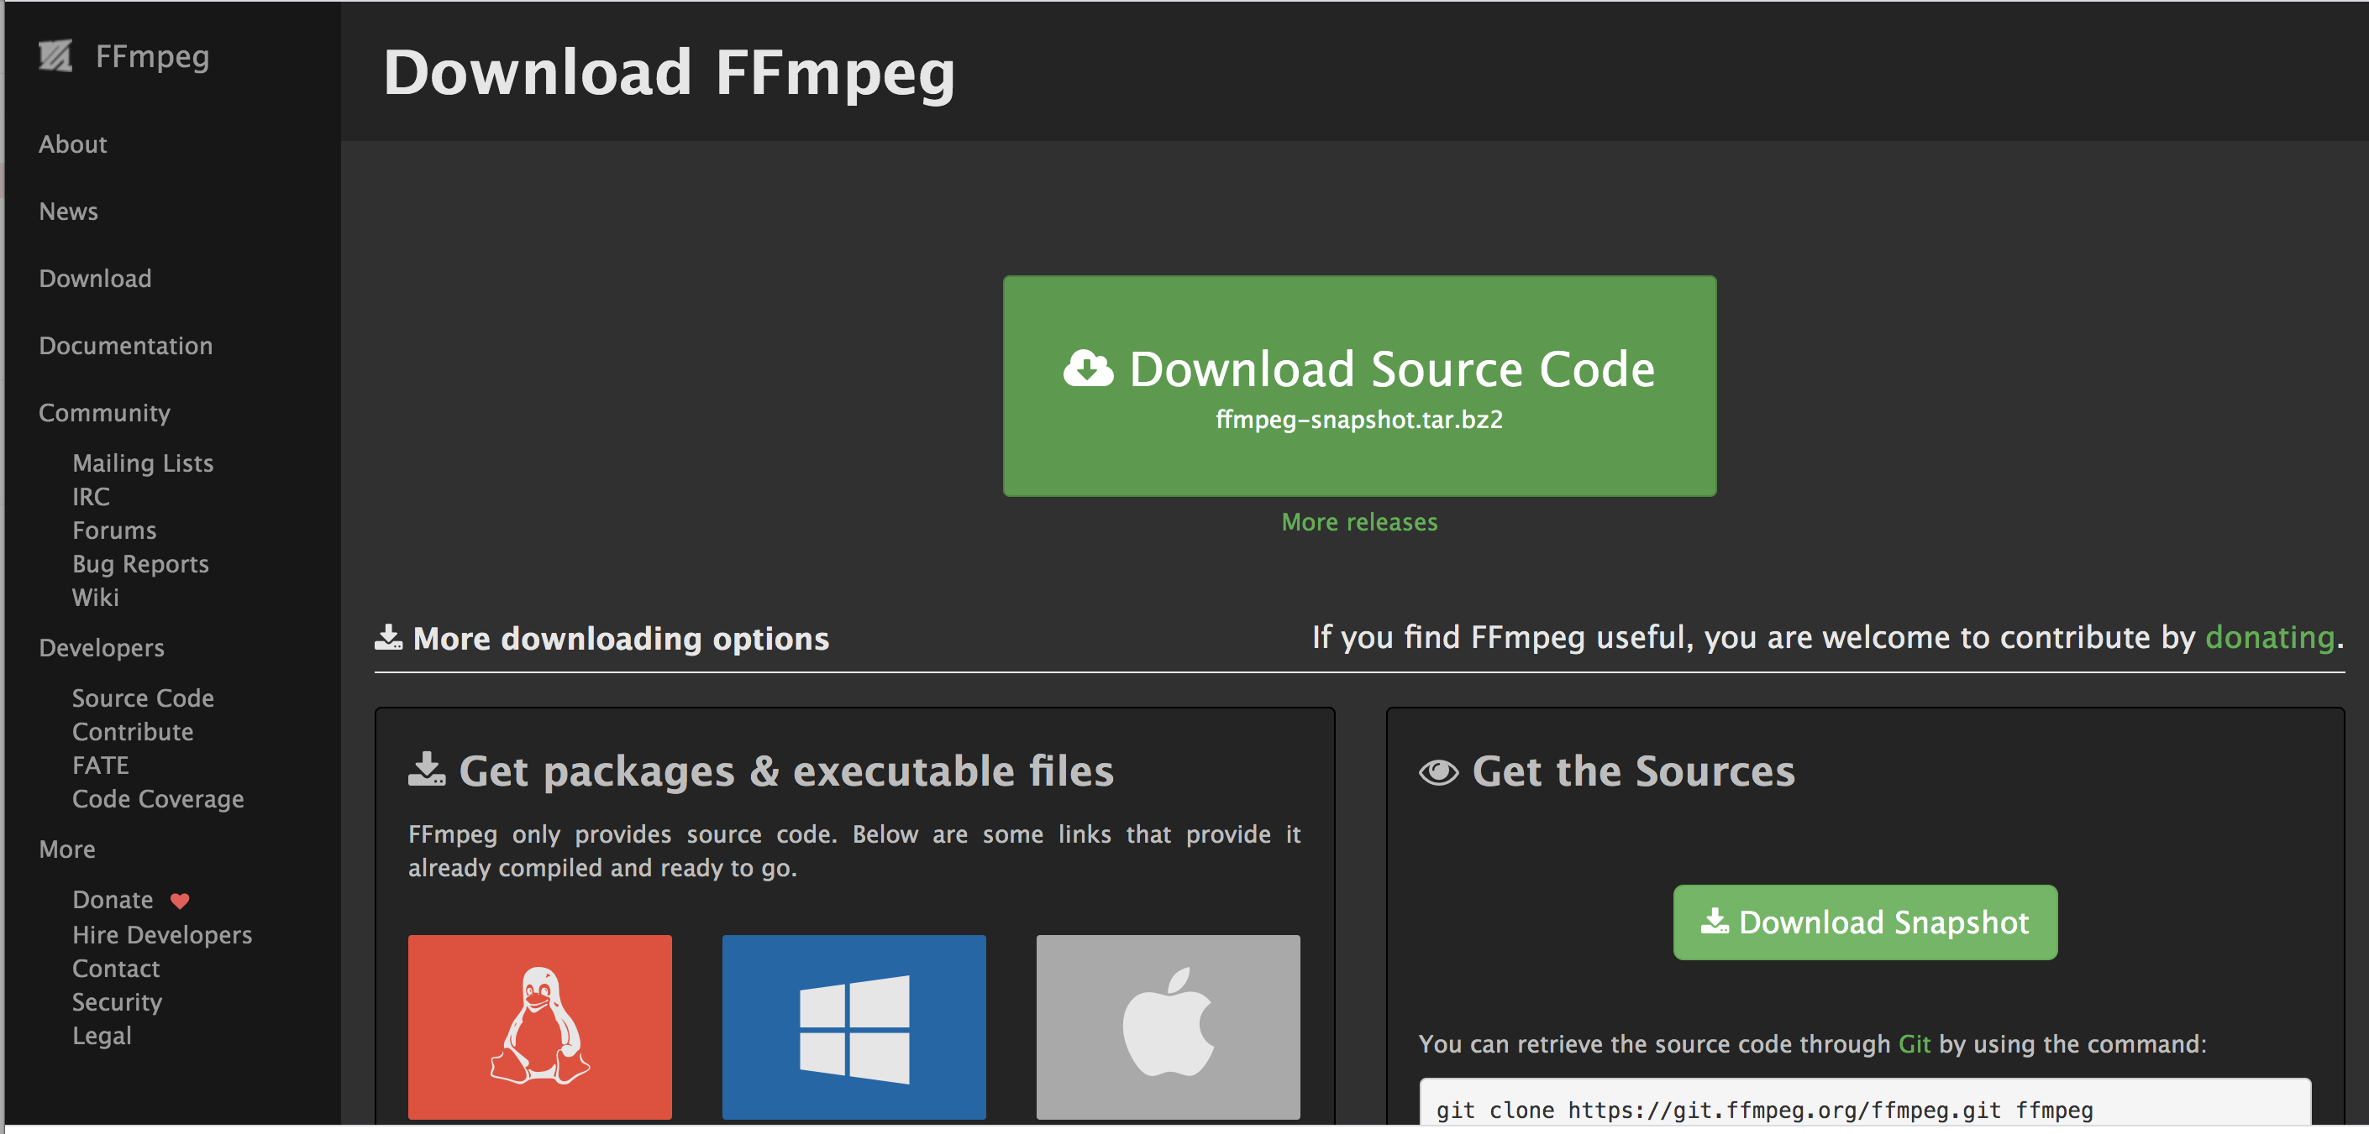
Start by downloading ffmpeg (link in description)
Notes:
Slides by Nicole Cuneo – please credit if reusing portions!
Ffmpeg.org/download.html

Slide 2
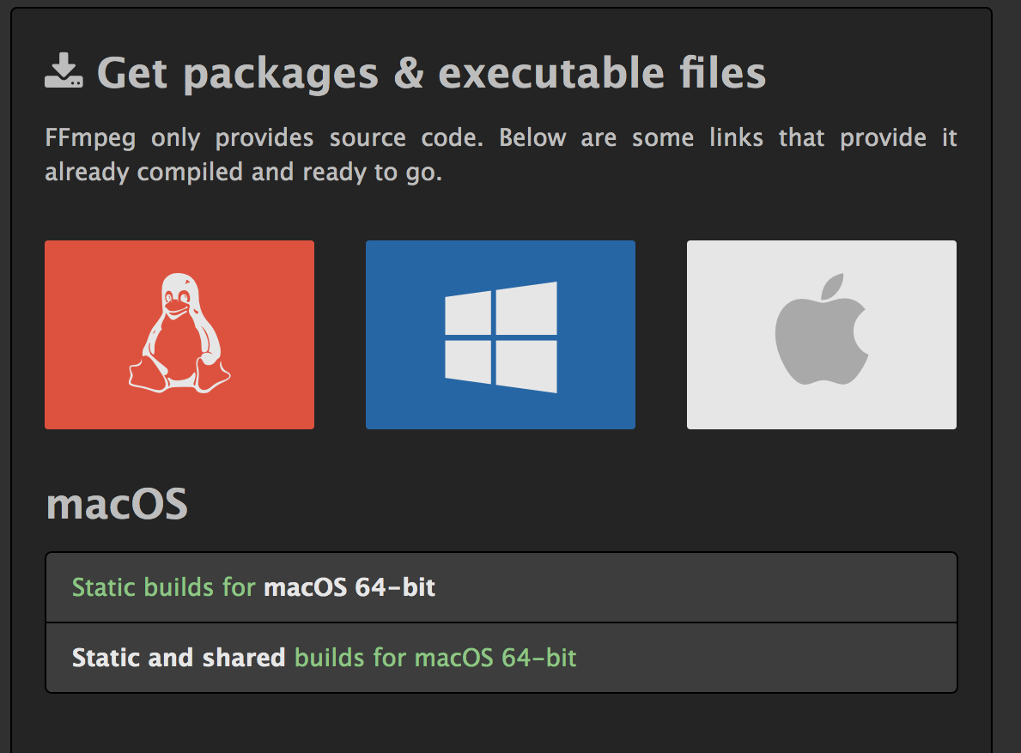
Start by downloading ffmpeg (link in description)
Make sure you pick the one correct one for your computer/ operating system!
Notes:
Ffmpeg.org/download.html

Slide 3
Prep for FFMPEG
Put all of your files in one folder, with your FFMPEG downloaded “app”
Check your permissions, make sure it’s okay to run an application downloaded from the internet (sometimes it blocks applications and/or specific commands)
Check the administrative rights on your computer
You will need to open a console as an administrator
For Macs- download “homebrew” (see slides)

Slide 4
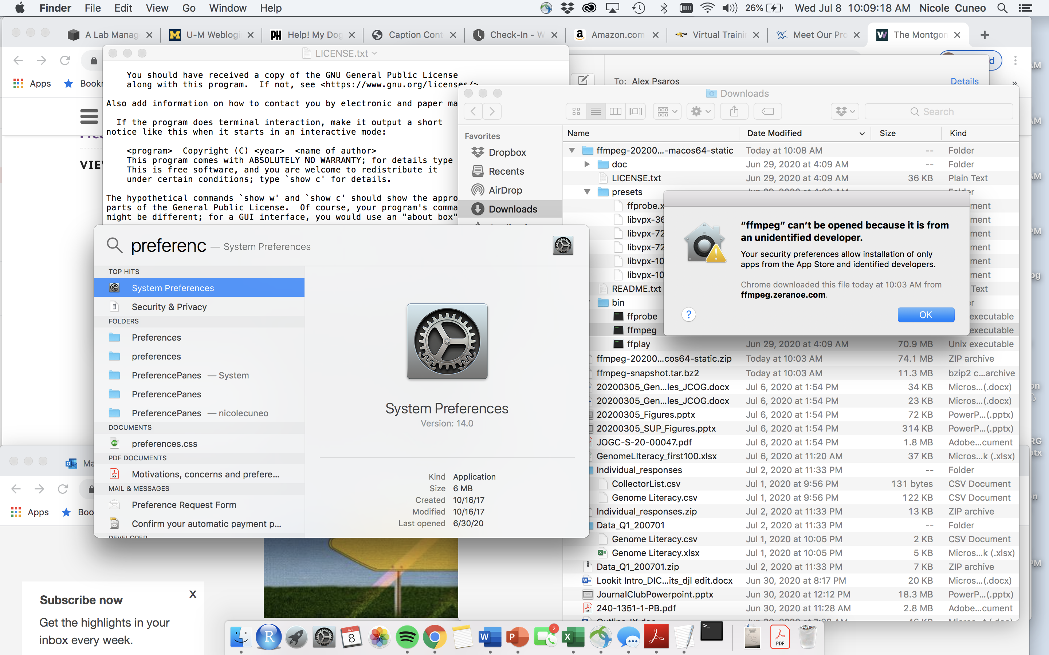
Prep for FFMPEG
Put all of your files in one folder, with your FFMPEG downloaded “app”
Check your permissions, make sure it’s okay to run an application downloaded from the internet (sometimes it blocks applications and/or specific commands)
Check the administrative rights on your computer
You will need to open a console as an administrator
For Macs- download “homebrew” (see slides)

Slide 5
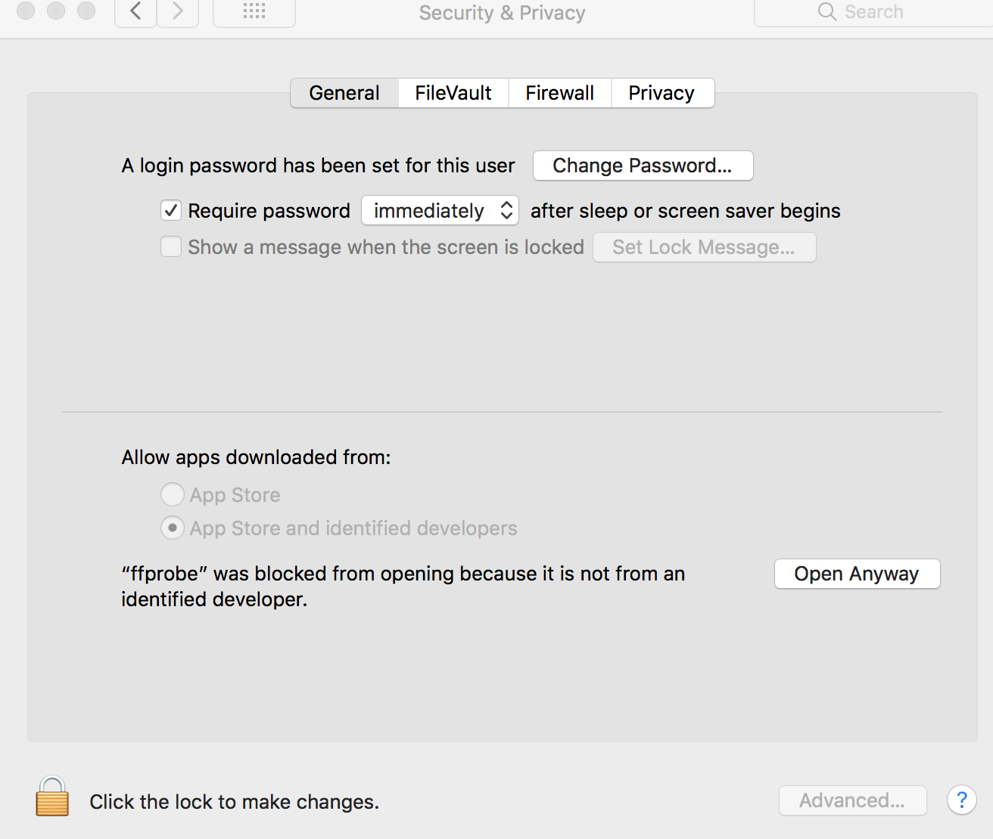
Prep for FFMPEG
Put all of your files in one folder, with your FFMPEG downloaded “app”
Check your permissions, make sure it’s okay to run an application downloaded from the internet (sometimes it blocks applications and/or specific commands)
Check the administrative rights on your computer
You will need to open a console as an administrator
For Macs- download “homebrew” (see slides)
Go to system preferences → general → open anyway

Slide 6
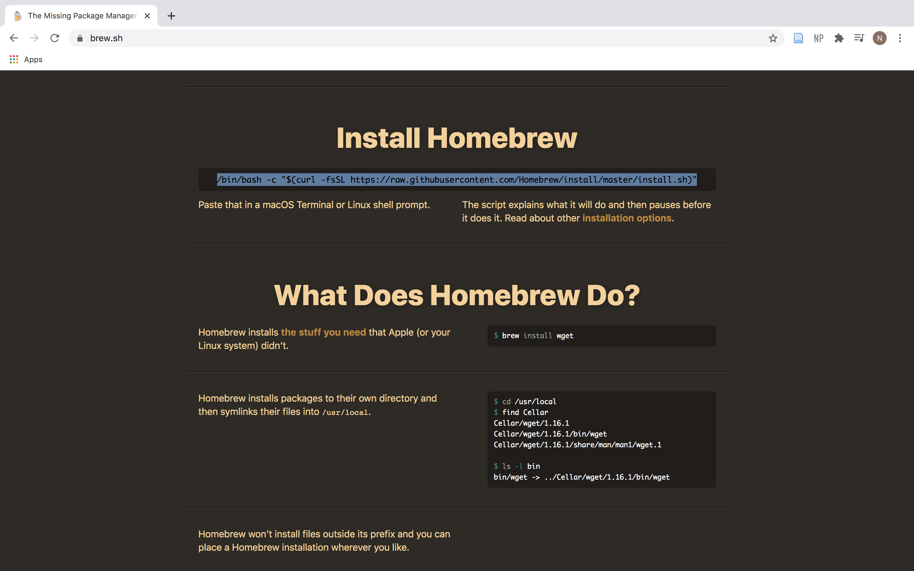
FFMPEG for Macs
Install Homebrew
(Link in notes)
Copy the code below “install homebrew”
Notes:
Brew.sh

Slide 7
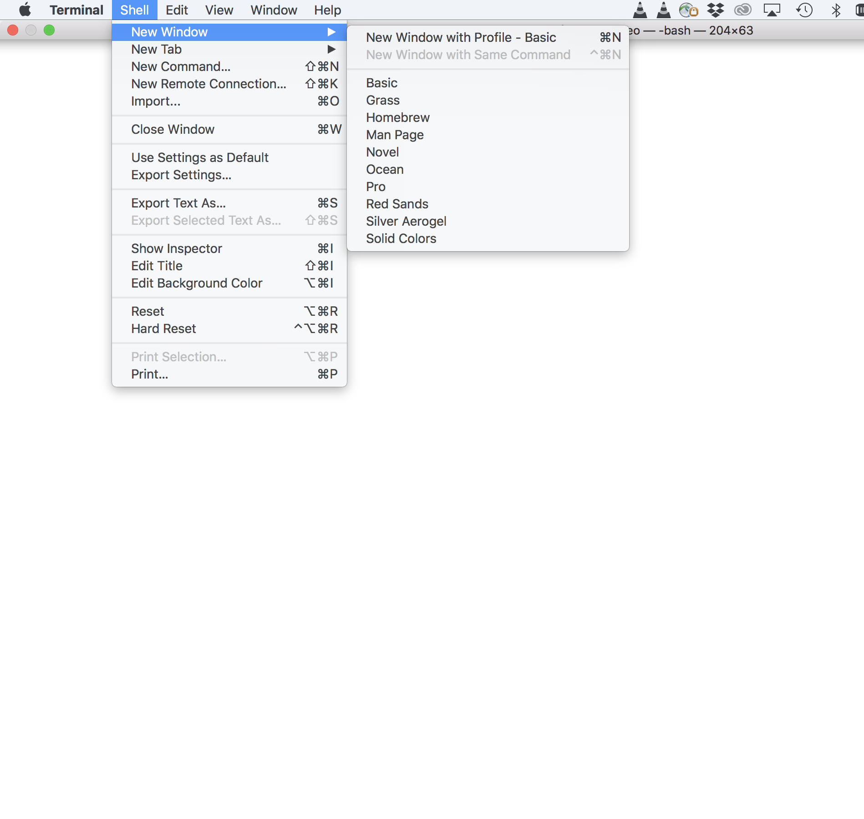
FFMPEG for Macs
Install Homebrew
(Link in notes)
Copy the code below “install homebrew”
Notes:
Brew.sh

Slide 8

FFMPEG for Macs
Install Homebrew
(Link in notes)
Copy the code below “install homebrew”
Notes:
Brew.sh

Slide 9
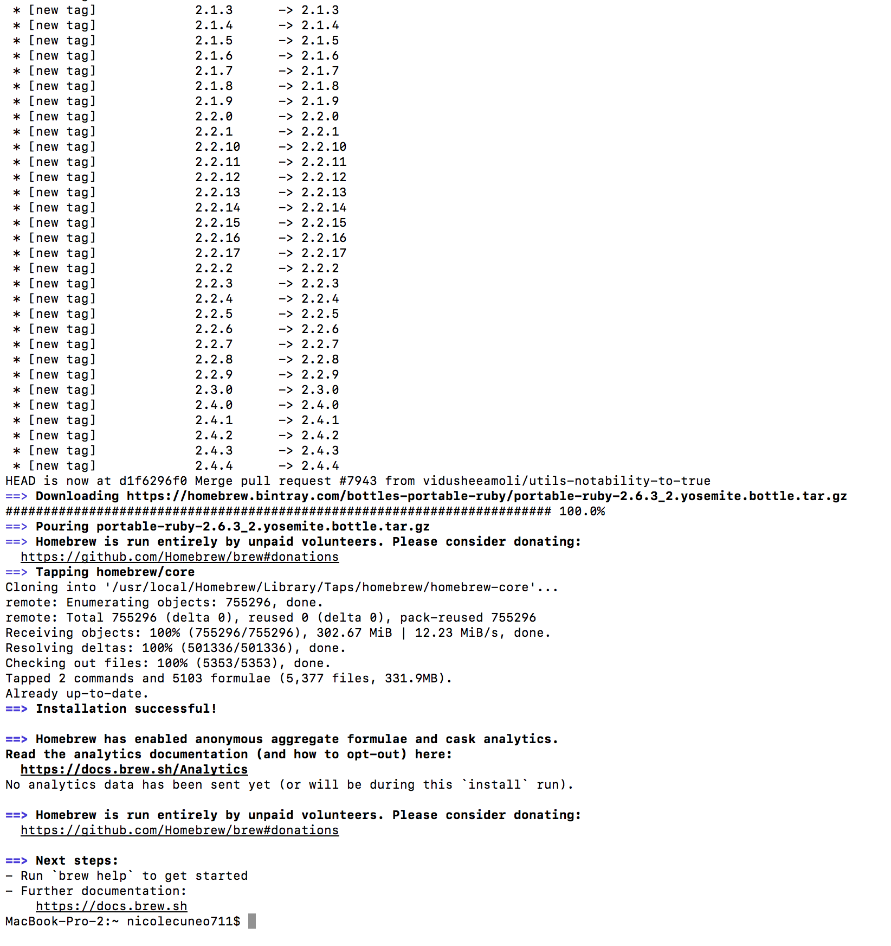
FFMPEG for Macs
Install Homebrew
(Link in notes)
Copy the code below “install homebrew”
Let run until you see your desktop name again
Notes:
Brew.sh

Slide 10
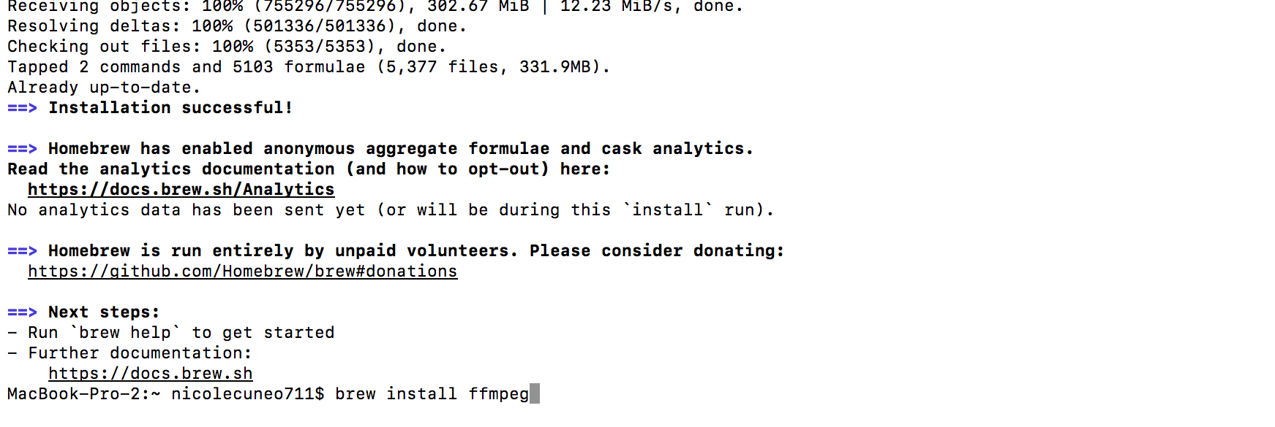
FFMPEG for Macs
Install Homebrew
(Link in notes)
Copy the code below “install homebrew”
Let run until you see your desktop name again
Test to see if it worked by typing in ffmpeg
Notes:
Brew.sh

Slide 11
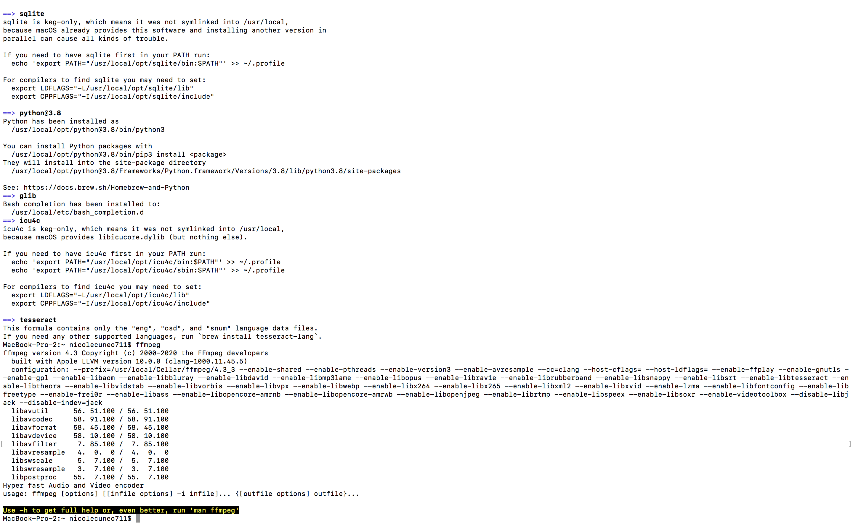
FFMPEG for Macs
Install Homebrew
(Link in notes)
Copy the code below “install homebrew”
Let run until you see your desktop name again
Test to see if it worked by typing in ffmpeg
If you see this- success!
Notes:
Brew.sh

Slide 12
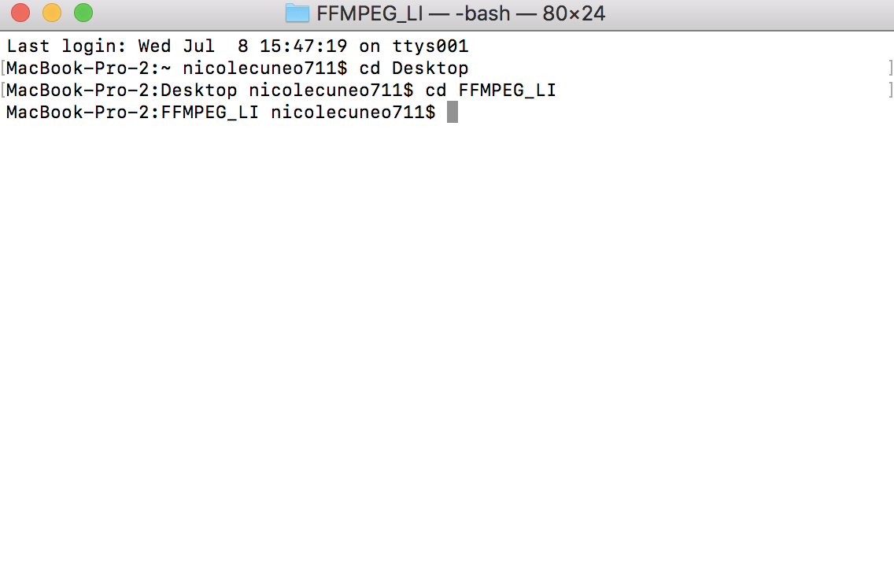
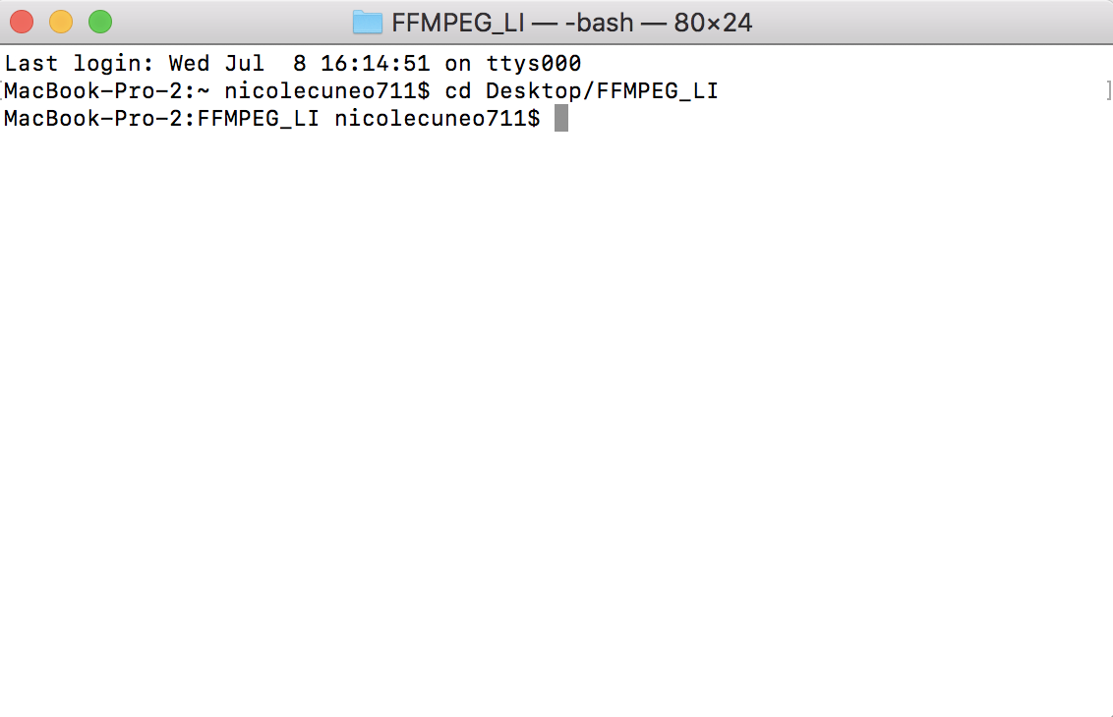
FFMPEG for Macs
2. Pick the location of your files
Add “cd” and then the location
You can do this piece by piece (can be helpful if you don’t know the path name) or all together (easiest!)
**piece by piece
First: desktop
Then: designated folder (for videos)
Notes:
Brew.sh

Slide 13
FFMPEG for Macs
2. Pick the location of your files
Add “cd” and then the location
You can do this piece by piece (can be helpful if you don’t know the path name) or all together (easiest!)
**piece by piece
First: desktop
Then: designated folder (for videos)
**all at once/ entire path
Notes:
Brew.sh

Slide 14
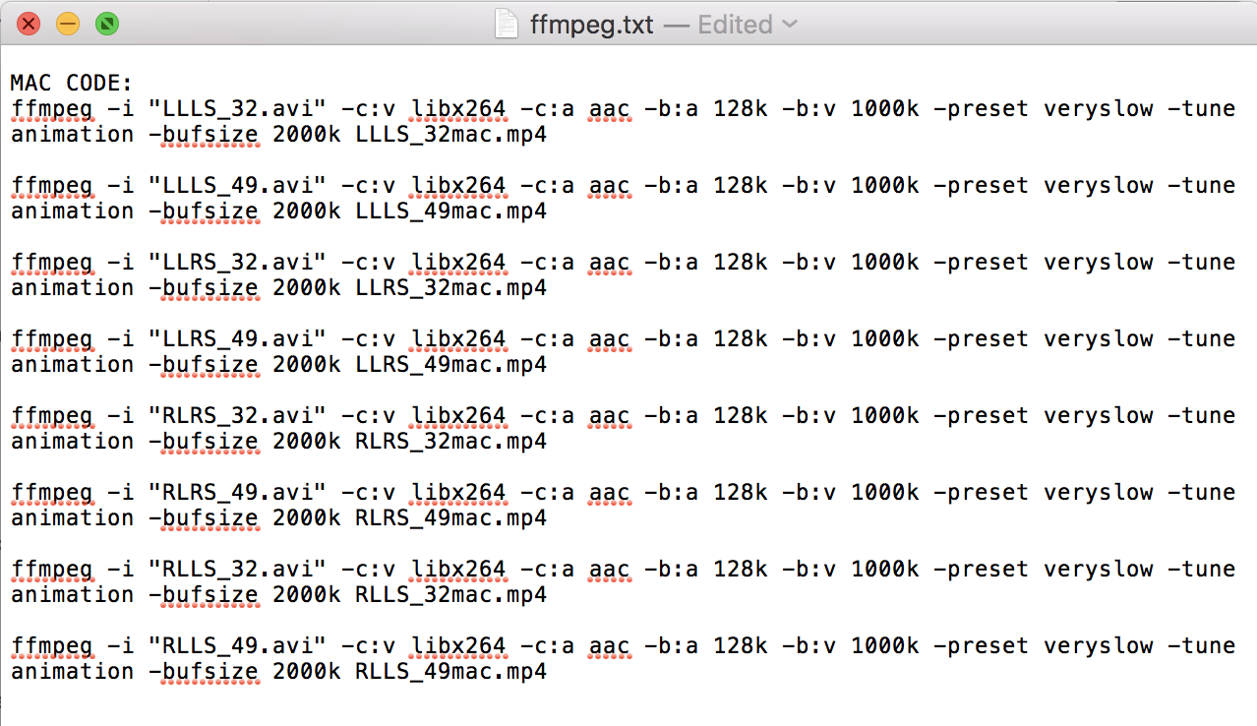
Shell: from Kim Scott; there’s more on the Lookit wiki
FFMPEG for Macs
3. Create your script
(Do this in a “txt” file so that you can just copy and paste the command right into the console
NOTE
**You cannot edit the command (other than the last character) so all editing must be done outside of the console
**for PCs you MUST use a “txt” file (notepad)
“Shell” (which I will create variations for)
ffmpeg -i "NAME.avi" -c:v libx264 -c:a aac -b:a 128k -b:v 1000k -preset veryslow -tune animation -bufsize 2000k NAME.mp4
Notes:
Brew.sh

Slide 15
Shell: from Kim Scott; there’s more on the Lookit wiki
FFMPEG for Macs
3. Create your script
(Do this in a “txt” file so that you can just copy and paste the command right into the console
NOTE
**You cannot edit the command (other than the last character) so all editing must be done outside of the console
**for PCs you MUST use a “txt” file (notepad)
ffmpeg -i "NAME.avi" -c:v libx264 -c:a aac -b:a 128k -b:v 1000k -preset veryslow -tune animation -bufsize 2000k NAME.mp4
Variations (in txt file)
Notes:
Brew.sh

Slide 16
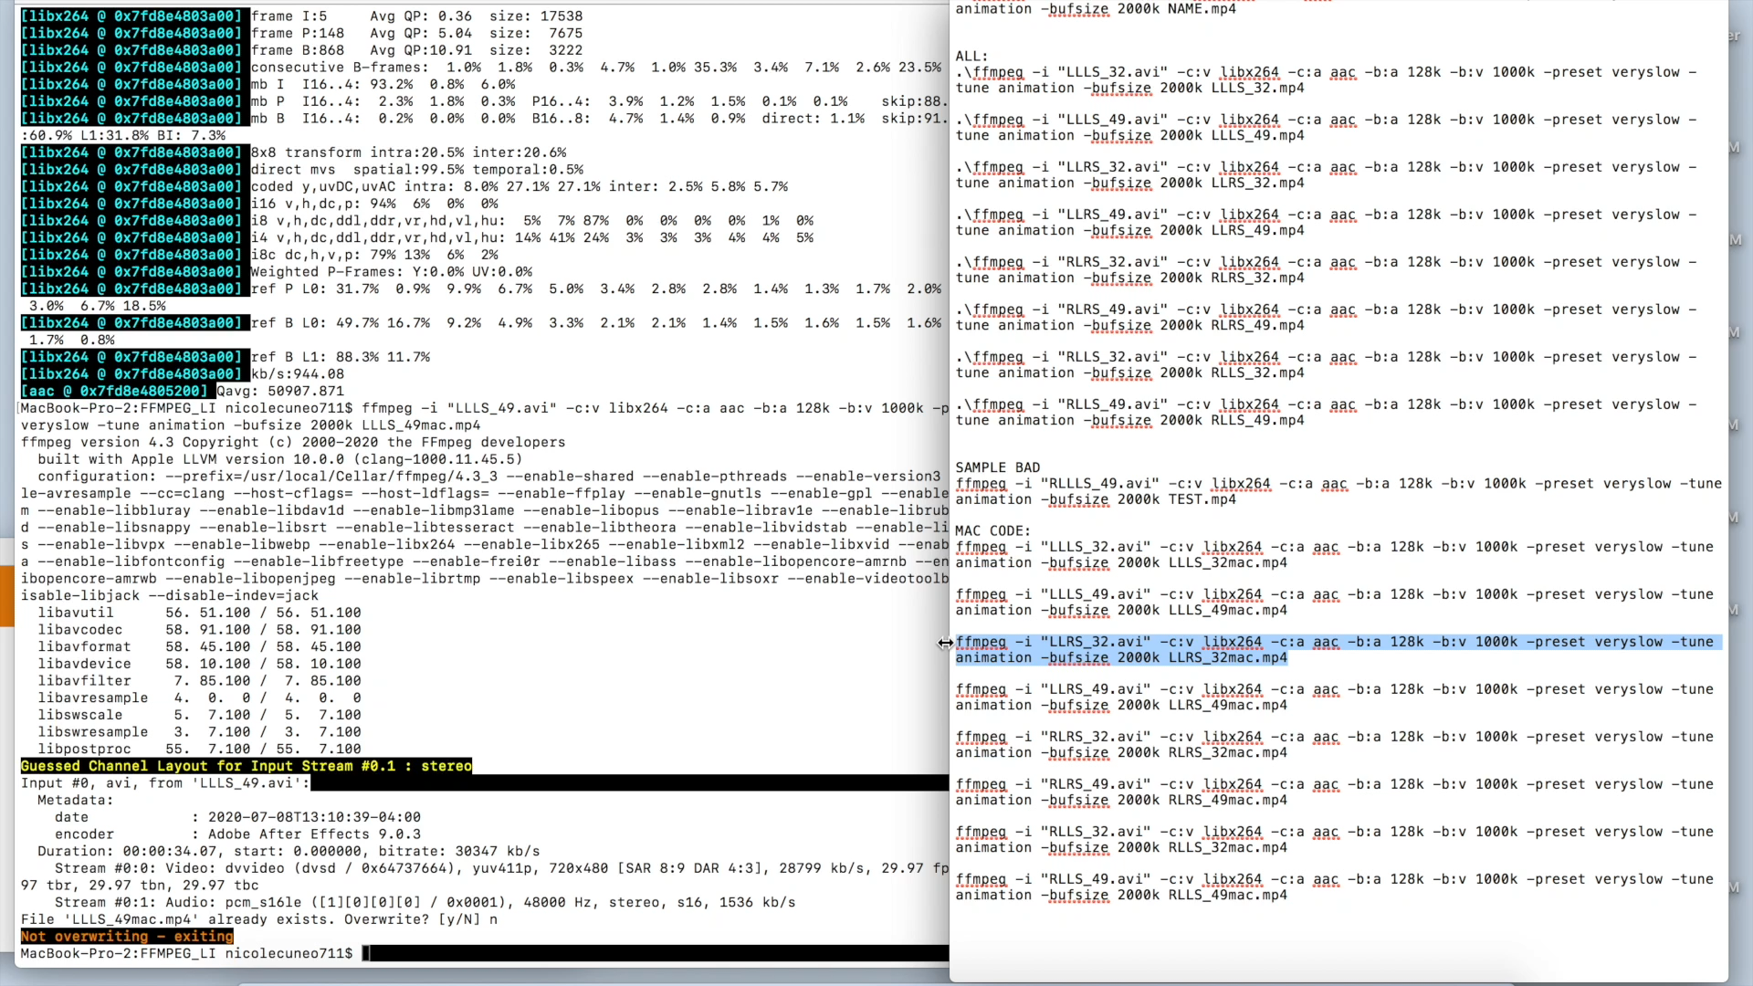
Video Version of “Copy and pasting command”
(Sped up because it does take a little while)
FFMPEG for Macs
3. Copy and paste your command into the console
Notes:
Brew.sh

Slide 17
FFMPEG for PCs
Put all of your files in one folder, with your FFMPEG downloaded “app”
Check your permissions, make sure it’s okay to run an application downloaded from the internet (sometimes it blocks applications and/or specific commands)
Check the administrative rights on your computer
You will need to open a console as an administrator

Slide 18
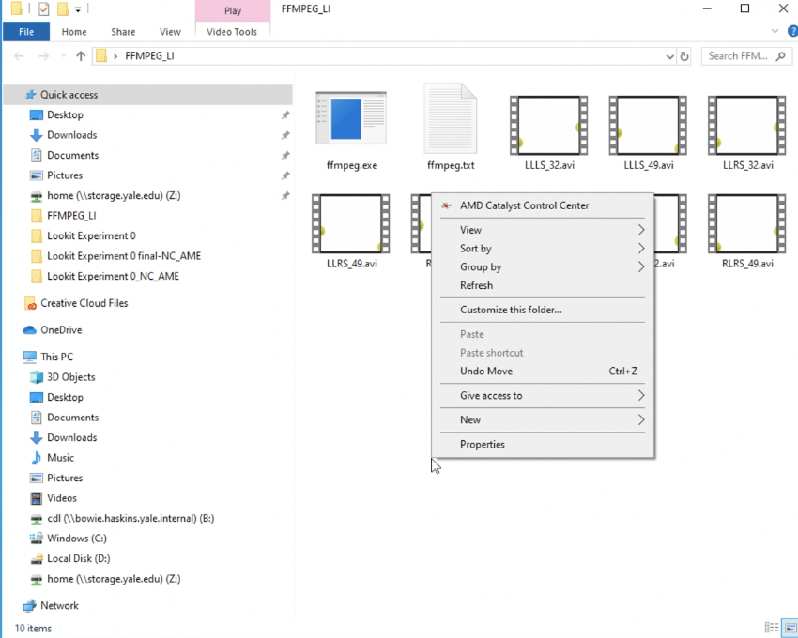
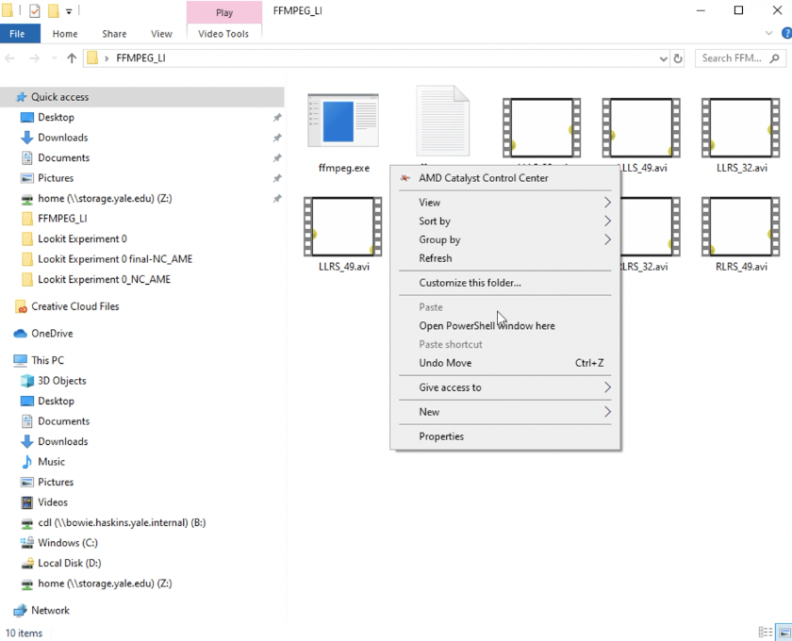
FFMPEG for PCs
Open the folder (with your stimuli and ffmpeg app)
Press ”shift” and right click at the same time
Wrong: if you don’t hold shift your menu options will look like this
Correct: see below (name may vary based on PC)

Slide 19
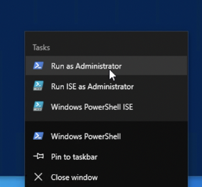
FFMPEG for PCs
3. If sharing a computer (or not the admin): when the window pops up, right click the icon and click “run as administrator”

Slide 20
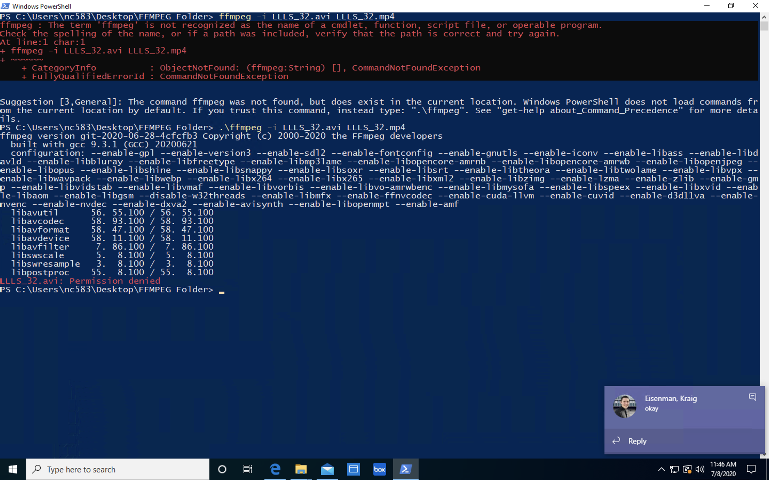
FFMPEG for PCs
3. If sharing a computer (or not the admin): when the window pops up, right click the icon and click “run as administrator”
Note: you might be able to do some commands using a non-administrator account. However, you will not be able to do everything. Your error will look something like this:

Slide 21
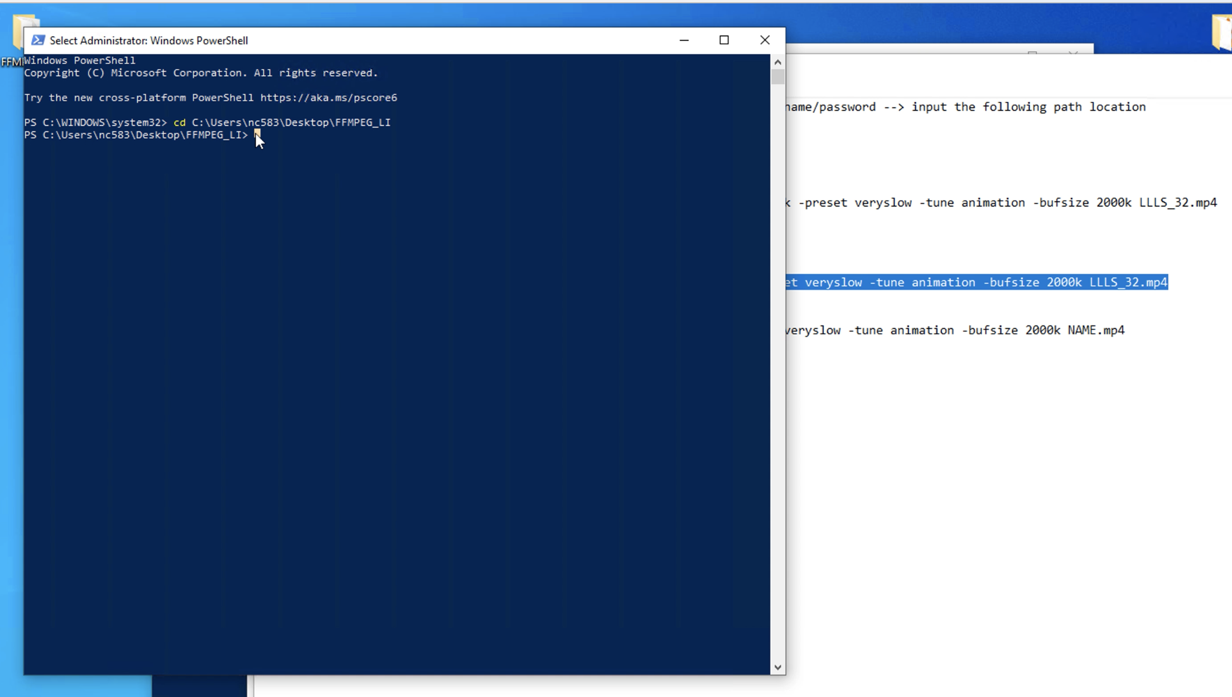
FFMPEG for PCs
3. Insert the path location (tip: pressing “tab” can help you locate your folder)

Slide 22
FFMPEG for PCs
3. Insert the path location (tip: pressing “tab” can help you locate your folder)
When you did this correctly- the folder location is put on the left side of the arrow

Slide 23
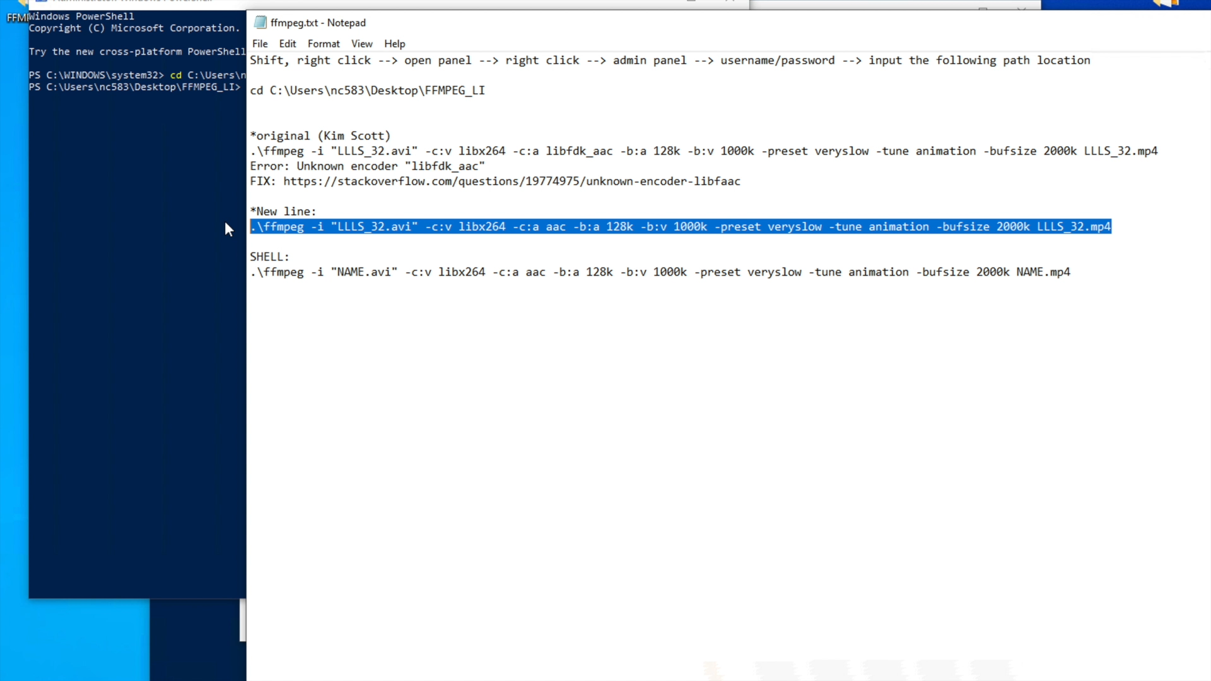
FFMPEG for PCs
4. In a .txt (notepad) file, write out/manipulate your command (note: I tried to do it on an email draft/word document and it wouldn’t paste for me. A .txt file may not be the only file type that works.

Slide 24
Video for copy and pasting the commands (sped up)
FFMPEG for PCs
5. Copy and paste your command into the console

Slide 25
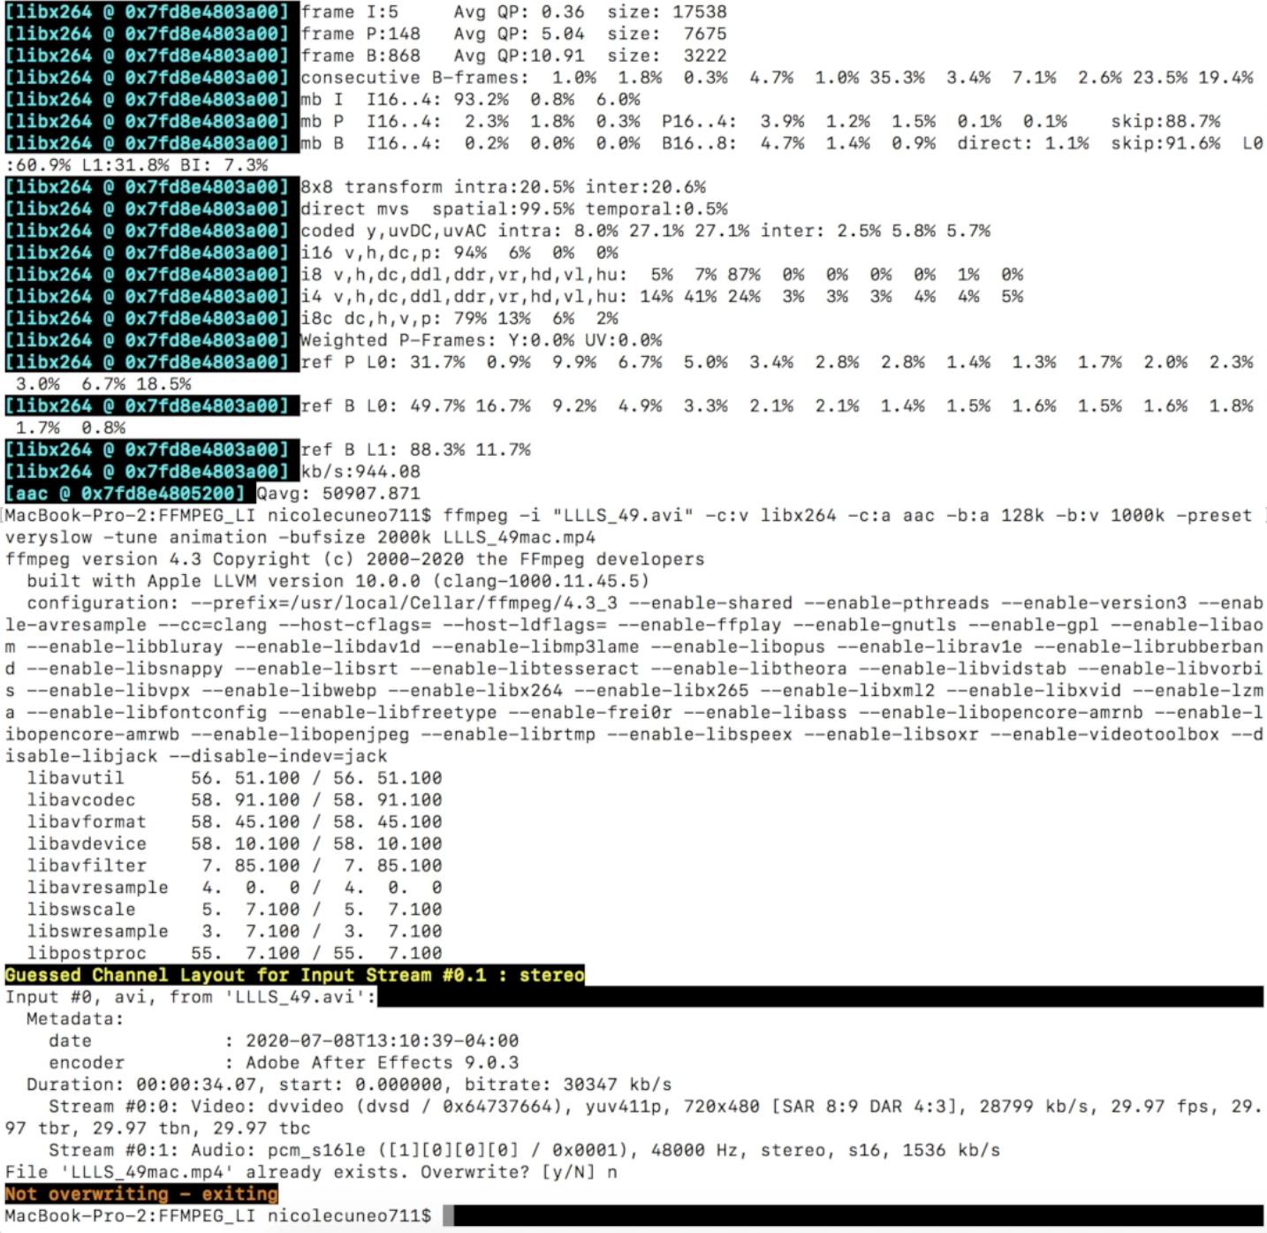
FFMPEG General Notes
If you paste the same command twice (or already have a video with that name)
“Overwrite? [y/N]

Slide 26
FFMPEG General Notes
If you paste the same command twice (or already have a video with that name)
Type “n” to cancel

Slide 27
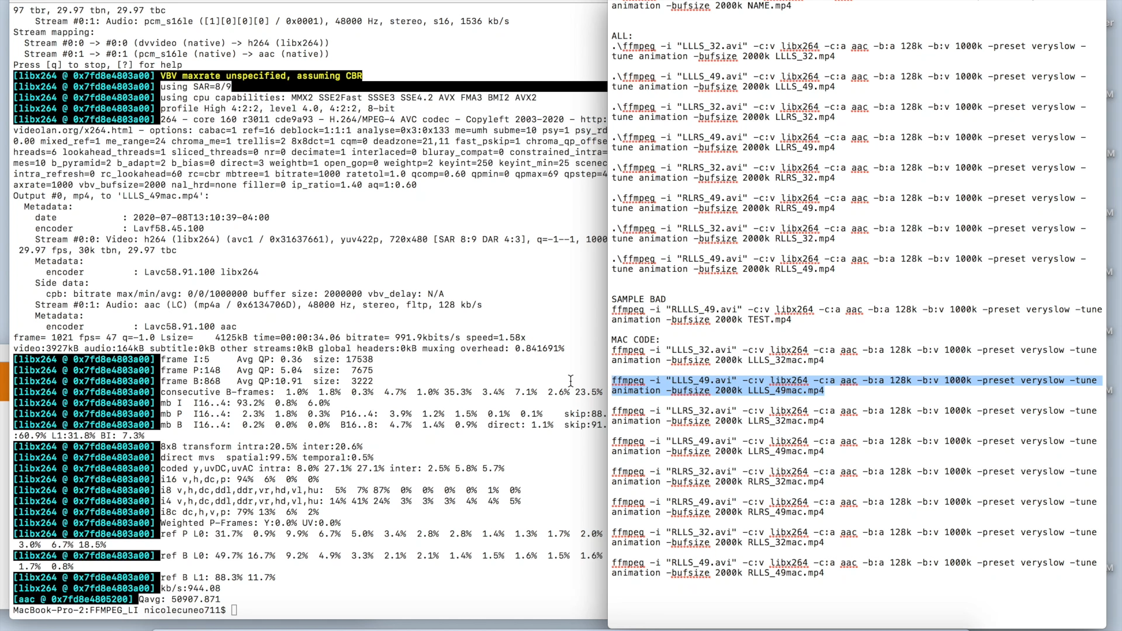
Video Version of “Overwrite”
FFMPEG General Notes
If you paste the same command twice (or already have a video with that name)

Slide 28
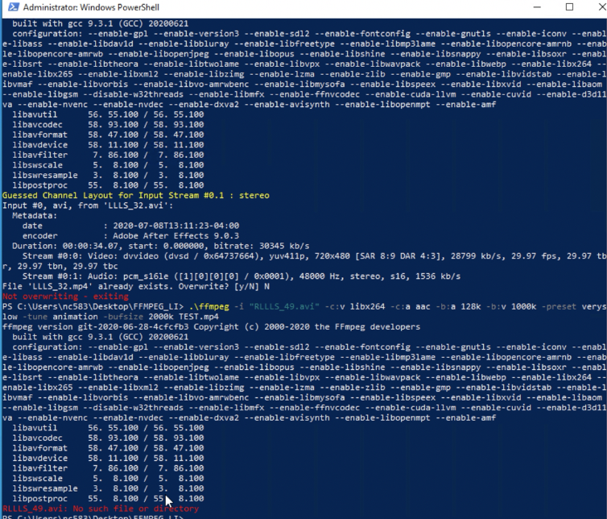
FFMPEG General Notes
If you paste a command with wrong information (e.g., mistyped video name)- this will appear
Error message

Slide 29
FFMPEG General Notes
If you paste a command while not using the administrator setting
Note: you might be able to do some commands using a non-administrator account. However, you will not be able to do everything.

Slide 30

FFMPEG General Notes
Use VLC to view these newly converted videos!
Notes:
https://www.videolan.org/vlc/

